Slide 1

Evaluation of Genotoxic effects of untreated Textile dye effluent
Using Mitotic index as the end point
Prathibha Nirmani

Slide 2

What is genotoxicity?
The ability of harmful substances to damage the genetic material within cell, leading to mutations and potential cancer
Chemicals such as heavy metals and Azo dyes, often found in textile dye effluents, are known genotoxic agents that pose risks to both flora and fauna

Slide 3
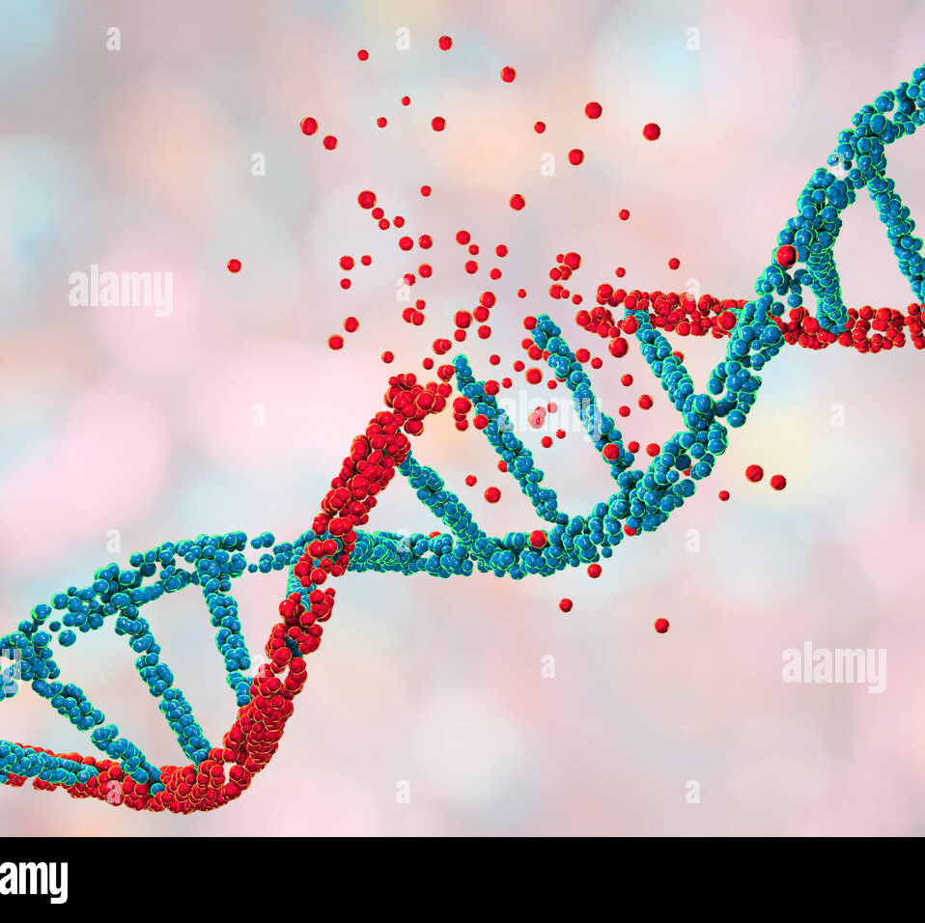
Importance of assessing genotoxicity
Provides a critical insights into the effects of contaminants on ecosystems and public health.
By understanding how substances effect genomic integrity, appropriate measures can be taken to mitigate risks associated with untreated effluents

Slide 4

Textile dye effluents and ecosystem impact
Untreated textile effluents are a significant source of pollution
Containing persistent organic chemicals that disrupt aquatic ecosystems
Can lead to biomagnification through the food chain, with adverse effects on both aquatic and terrestrial organisms

Slide 5

Objective
· To introduce the concept of genotoxicity and its assessment using the mitotic index
· To demonstrate data analysis techniques in R for statistical comparison of mitotic index values across different effluent concentrations
· To interpret results and determine the potential genotoxic effects of untreated textile dye effluent

Slide 6
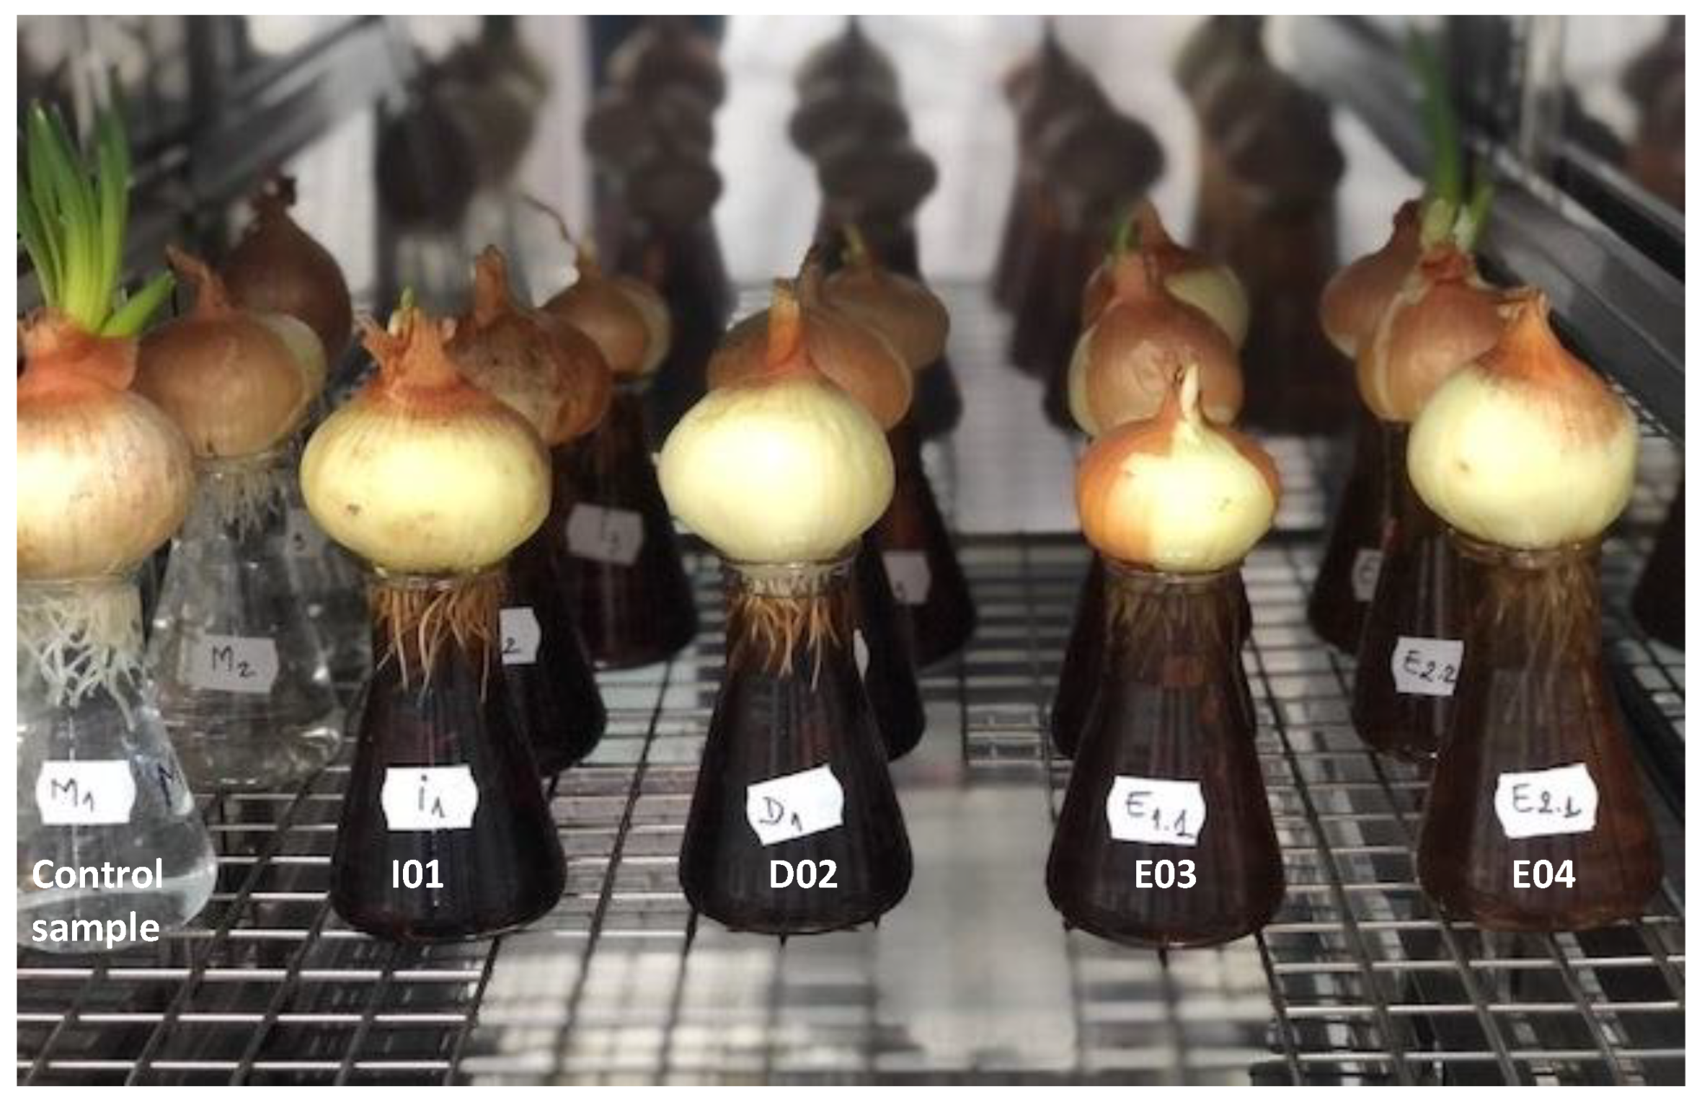
Methodology
Selection of healthy Allium cepa bulbs for the exposure
Kept them for rooting
Preparing exposure concentrations of 0%, 25%,50% and 100% untreated textile dye effluent and exposing
Staining and microscopic observation after 48 hours

Slide 7
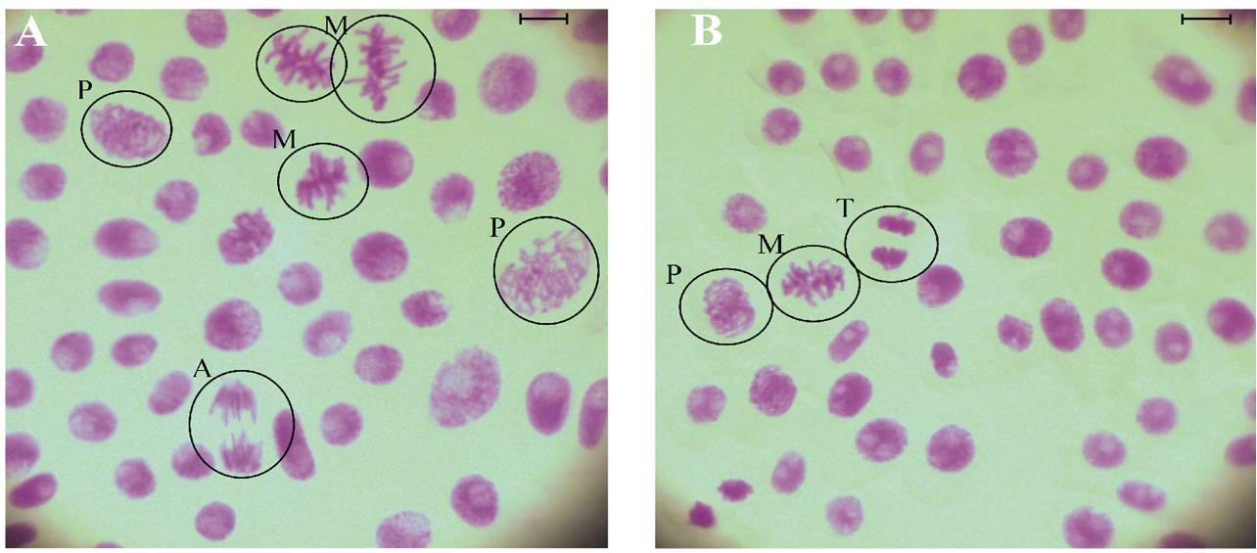
Calculation of mitotic index
The mitotic index was calculated using the formula:
Mitotic index = Number of dividing cells × 100
Total number of cells
This quantifies the proportion of cells undergoing division, providing insight into the potential genotoxic effects of textile dye effluents at varying concentrations

Slide 8

Data Analysis
Visual representation
Represent the distribution of mitotic index values for each concentration of effluent
This aids in facilitating a clear comparison across groups

Slide 9
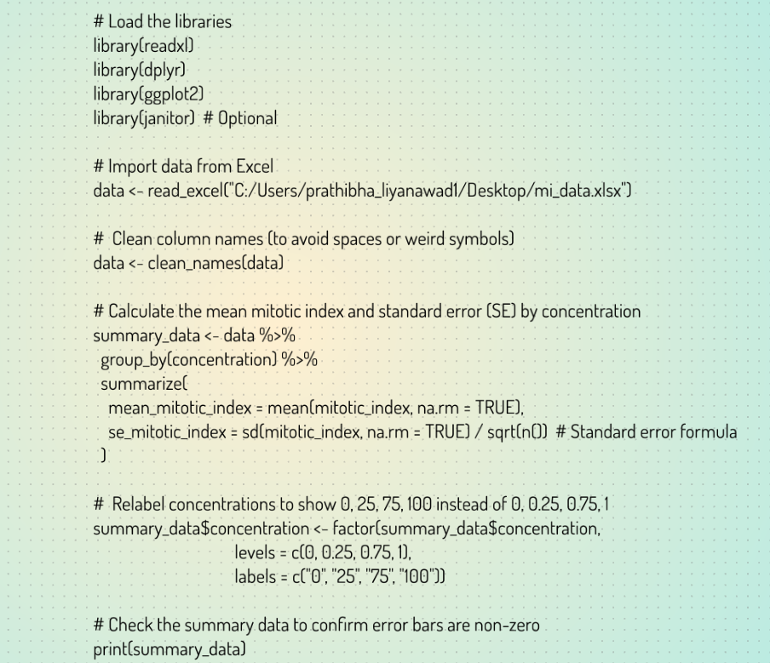
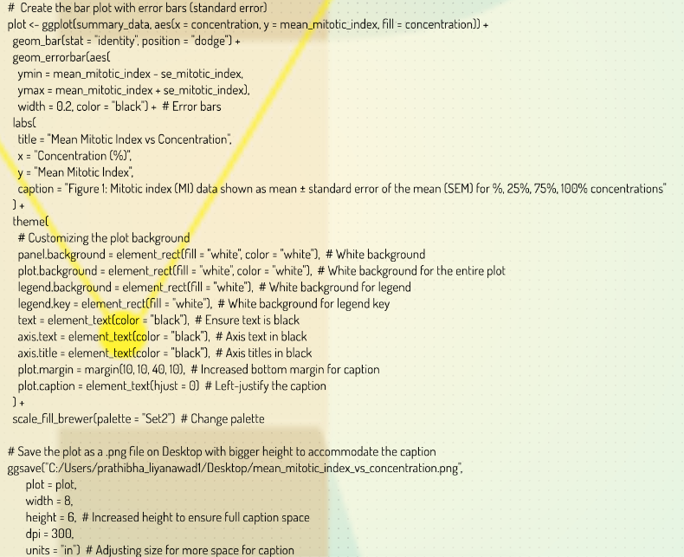

Slide 10
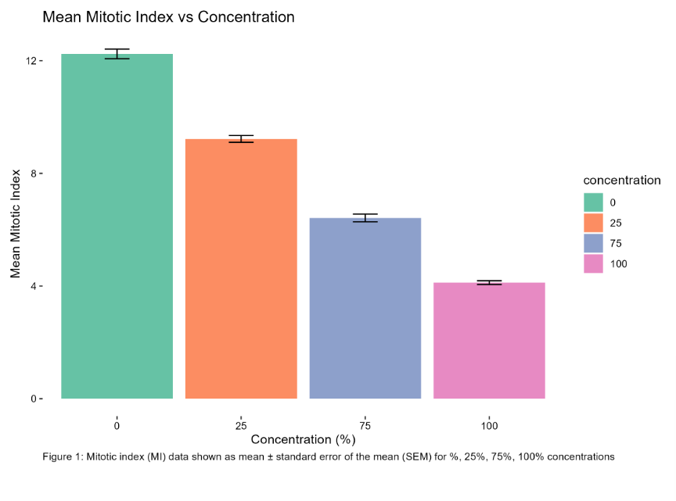

Slide 11
One- Way ANOVA test results
One- way ANOVA was performed to compare the means of mitotic index across the different concentrations
Significant differences were observed, indicationg that untreated textile dye effluent has genotoxic effects on cellular activity and division

Slide 12
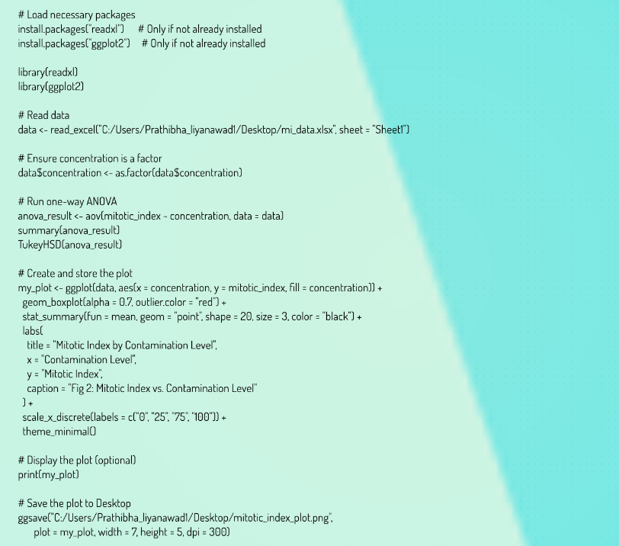

Slide 13
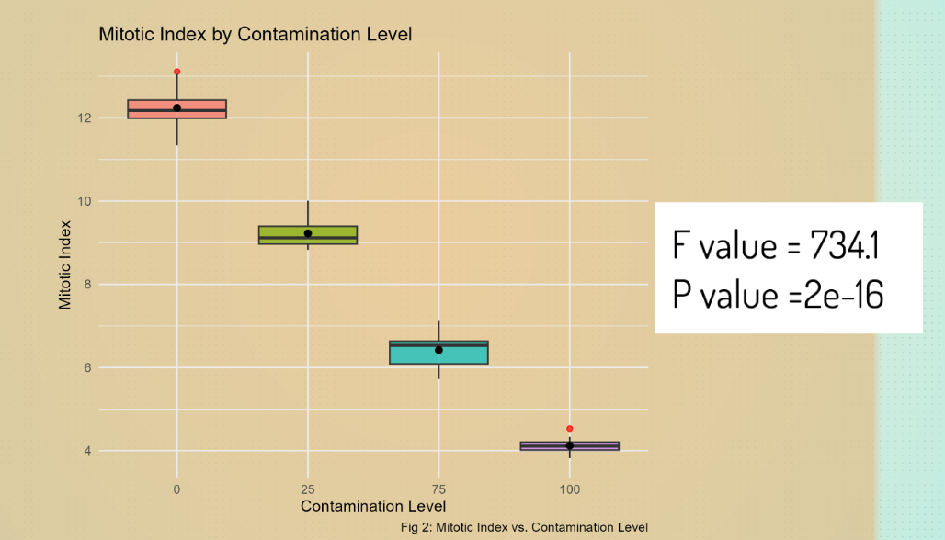

Slide 14
Conclusion
The analysis concludes that the different concentrations of untreated textile dye effluent significantly affect the mitotic index, indicating potential genotoxicity
These findings underscore the environmental risks posed by untreated dye effluents and the necessity for treated water in ecological sustainability

Slide 15
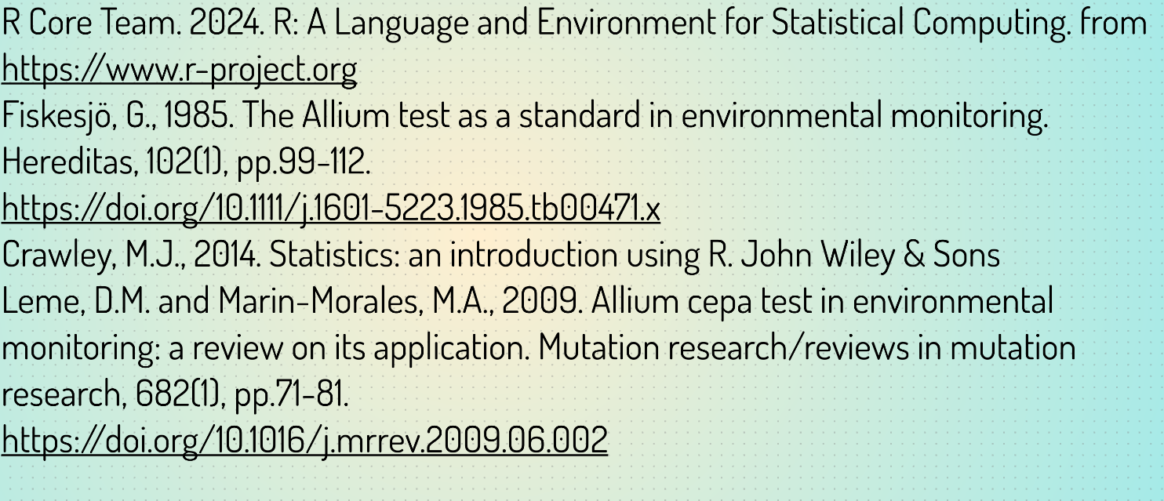
References

